Slide 1
Designing Meaningful Visuals for eLearning
Learn how to source and design meaningful images and graphics for eLearning modules
Jerusha Ellis, MScBMC, CMI - Education Specialist & Medical Illustrator, de Souza Institute
Jiahui Wong, MD, PhD - Scientist and Manager, de Souza Institute
Notes:
Today, I wanted to share with you some strategies I use when designing and sourcing images and graphics for our online courses. This is something I’ve seen course authors and designers struggle with in the past. So I hope these strategies will be useful to you too.
Even though the title of the workshop is “Designing Meaningful Visuals for eLearning” the strategies will be applicable to designing lecture slides or print handouts too.

Slide 2
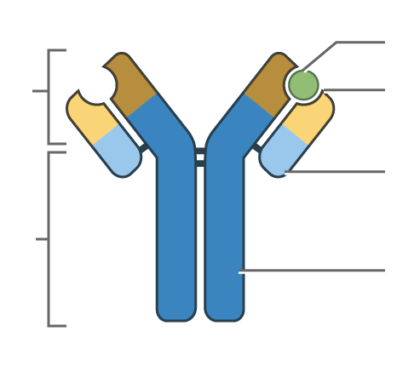
People learn better from words & pictures than from words alone.
immunoglobulins
Antigen
An immunoglobulin (Ig) is a Y shaped protein made of four polypeptide chains, two light chains and two heavy chains. Each end of the immunoglobulin has a distinct purpose. The top of the Y is known as the variable domain. The variable domain establishes the unique antigen binding of that specific Ig. The bottom of the Y is the constant domain and is responsible for activating the immune system through its interaction with cell surface receptors.
Variable domain
Antigen binding site
Light chain
Constant domain
Heavy chain
Immunoglobulin (antibody) structure.
(Clark & Mayer, 2016; Mayer, 2021)
Notes:
When we say “visuals” or “pictures” that can be many things: photos, illustrations, diagrams, flow charts, and infographics.
But, why is thinking about images useful for those working in health professions education?
…its because Research in the field of Multimedia Learning has long shown that “people learn better from words and pictures than from words alone” (Clark & Mayer, 2016; Mayer, 2021). Research has demonstrated that students who learn from diagrams score better on retention and transfer tests vs. those who read a text passage alone (Clark & Mayer, 2016; Mayer, 2021). But, I’ve noticed that many online courses rely on text-heavy materials that don’t reflect these best practices. Text-only learning materials are often easier and faster to produce, and this has been especially true during the last two pandemic years with the rapid shift to online learning.
The example on the slide is similar to the comparisons that Multimedia Learning research has looked at, on the left is a schematic image of an antibody vs. on the right is a text description of the same content.

Slide 3
Poorly chosen graphics can disrupt learning.
immunoglobulins
The bottom of the Y is the constant domain and is responsible for activating the immune system through its interaction with cell surface receptors.
An immunoglobulin (Ig) is a Y shaped protein made of four polypeptide chains, two light chains and two heavy chains. Each end of the immunoglobulin has a distinct purpose.
Antigen
An immunoglobulin (Ig) is a Y shaped protein made of four polypeptide chains, two light chains and two heavy chains. Each end of the immunoglobulin has a distinct purpose. The top of the Y is known as the variable domain. The variable domain establishes the unique antigen binding of that specific Ig. The bottom of the Y is the constant domain and is responsible for activating the immune
Variable domain
Antigen binding site
Light chain
Constant domain
Heavy chain
Immunoglobulin (antibody) structure.
The top of the Y is known as the variable domain. The variable domain establishes the unique antigen binding of that specific Ig. The bottom of the Y is the constant domain and is responsible for activating the immune system through its interaction with cell surface receptors.
Image: iStock Photo
system through its interaction with cell surface receptors.
(Clark & Lyons, 2010; Clark & Mayer, 2016; Mayer, 2021)
Notes:
However, not all visuals are equally useful in teaching. Education research has also shown that poorly chosen graphics do not have a neutral effect on the student’s ability to learn and can actually disrupt learning. (Clark & Mayer, 2016; Mayer, 2021)
Adding visuals that are topically related but extraneous to the learning objective can depressed learning by distracting learner’s attention away from what you are trying to teach (Clark & Lyons, 2010).
The example on the slide is similar to the comparisons this research has looked at, e.g., The left image of the antibody is supporting the learning objective and the accompanying text, while the image of the left obviously has nothing to do with the text describing structure of an antibody.

Slide 4
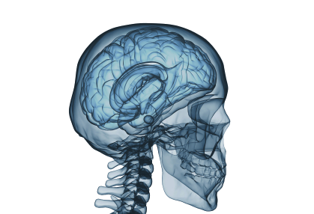
Two Major Challenges
Issues with stock art:
1
Knowing WHAT CONTENT can be visual:
Relying exclusively on text-heavy educational materials.
Including visuals that do not support the learning objectives.
Brain in backwards!
2
Knowing WHERE TO SOURCE quality images:
Using copyrighted images pulled from a web search.
Relying too heavily on stock art subscriptions:
Inaccurate anatomical or clinical images.
Cheesy and stereotyped images of health care environment.
Smiling happy health care workers
Images: iStock Photo
Notes:
Most people designing course slides or other educational materials know that images are important, but I see those who are new to creating educational materials struggle with the following two challenges:
Knowing WHAT CONTENT can be communicated visually, common mistakes are:
Relying exclusively on text-heavy educational materials
Including visuals that do not support the learning objectives
Knowing WHERE TO SOURCE quality images:
Using copyrighted images pulled from a web search.
Relying too heavily on stock art subscriptions…this can lead to:
Inaccurate anatomical or clinical images.
Cheesy and stereotyped images of health care environment.
So over the rest of the workshop, I’ll give you a framework and rationale for how to select graphics that support and promote your learning objectives, and at the end I give you some strategies for where to source quality images for your teaching.

Slide 5
Workshop Agenda
How do well-designed graphics promote learning?
What are the functions of graphics in teaching?
Designing Instructional Visuals that support your Learning Objective
Break out group – Image analysis and re-design.
An introduction to using Creative Commons and Public Domain image libraries.
Open Q & A
If you need to leave early… the workshop resource handout is available at: https://www.desouzainstitute.com/convergence-2022/
Notes:
Here a brief outline of the workshop today:
Start with a summary of the research for how well-designed graphics promote learning.
I’ll outline the different instructional Functions of Graphics in Teaching (an instructional design framework to use when looking at your teaching materials)
Break out group – for 15min – There will be one 15min break-out group where you’ll practice some of the strategies in a small group. You can also do this exercise alone if you’re not able to join a breakout group.
An introduction to sourcing quality images using Creative Commons and Public Domain image libraries
If you need to leave early, there’s a link on the slide to the workshop resource pdf with a summary of the workshop and list of image libraries I use to source images for our courses: https://www.desouzainstitute.com/convergence-2022/ ‎

Slide 6
CHAT POLL:
Why do you think people learn better from words and pictures than from words alone?

Slide 7
How well-designed visuals promote learning
MYTH
“Graphics add visual interest to materials in order to increase learner motivation.”
FACT
Graphics can help direct attention and promote the learner’s organization and integration of new knowledge.
MYTH
“Adding any type of visual improves learning outcomes.”
FACT
Graphics are only effective to the extent that they support rather than disrupt the psychological events of learning.
FACT
People like learning from materials with any visuals more than text alone, but there is no relationship between liking instruction and learning outcomes.
(Clark, 2020; Clark & Lyons, 2010)
Notes:
There are some common myths about how visuals promote learning that have been disproven by studies into multimedia learning.
Myth: Graphics are used to add visual interest to materials in order to increase learner motivation, and this motivation improves learning. (Clark & Lyons, 2010).
Fact: Graphics can help direct attention and promote the learner’s organization and integration of new knowledge. (Clark & Lyons, 2010).
Myth: Adding any type of visual improves learning outcomes (Clark & Lyons, 2010).
Fact: Graphics are only effective to the extent that they support rather than disrupt the psychological events of learning (i.e., what they mean by the “psychological events of learning” is the three steps we listed above. The student’s attention is directed at the key info, they are able to organize the new info in working memory, and integrate it into existing knowledge in long-term memory) (Clark & Lyons, 2010).
Fact: Research shows that people like learning from materials with any visuals more than materials with text alone, (even if the visuals are irrelevant or disruptive) but its important to note that research has consistently shown no relationship between how much the students liked the instructional materials and their learning outcomes (how much they’ve learned) (Clark, 2020; Clark & Lyons, 2010).

Slide 8
The Functions of Graphics in Teaching
Decorative & Editorial Graphics
Do not teach any content. Added for aesthetic or emotional appeal.
e.g., cover art, editorial art
Instructional Graphics
Teach content that supports a learning objective of the course.
e.g., a diagram, infographic, flow chart, or photograph of an example
(Clark & Lyons, 2010; Clark & Mayer, 2016)
Notes:
Over the next slides, I’ll present a framework for thinking about the function of graphics in teaching and learning that you can use to analyze your own teaching materials, and help you think about what content can be communicated visually.
We can classify all graphics in teaching materials into two categories:
Decorative Graphics
Do not teach any content. Added for aesthetic or emotional appeal.
e.g., cover art, editorial art
Instructional Graphics
Teach content that supports a learning objective of the course.
e.g., diagram, infographic, flow chart, photograph of an example
(Clark & Lyons, 2010; Clark & Mayer, 2016)
Decorative graphics have a role in education materials, but excessive use of decorative graphics risks interfering with the process of learning and best practices discourage their overuse. (Clark & Lyons, 2010) pg 16

Slide 9
5 Functions of Instructional Graphics
Representational
Appearance of something
Relational
Quantitative relationships
Organizational
Qualitative relationships
Transformational
Changes over time or space
Interpretive
Visualizes intangible phenomena
(Clark & Lyons, 2010; Clark & Mayer, 2016)
Notes:
Multimedia researchers have further classified Instructional Graphics based on their specific function, and what types of learning objectives that they support.
Representational Graphics
Show the appearance of a tangible object.
Relational Graphics
Show quantitative relationships between facts.
Organizational Graphics
Show qualitative relationships between facts or concepts.
Transformational Graphics
Show changes over time and space.
Interpretive Graphics
Visualizes intangible or invisible phenomena
Keeping these categories in mind will help you analyze your lesson content for WHAT CONTENT can be communicated visually.

Slide 10
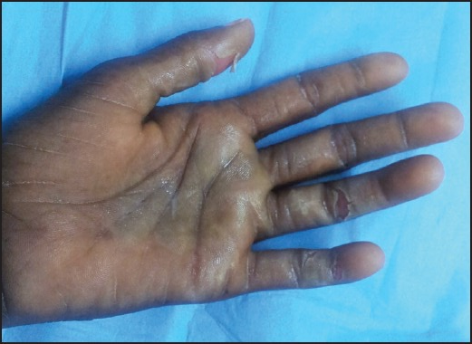
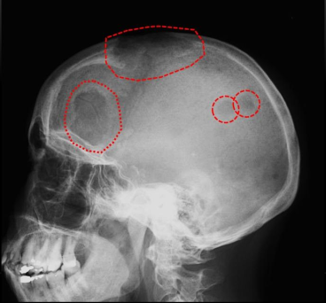
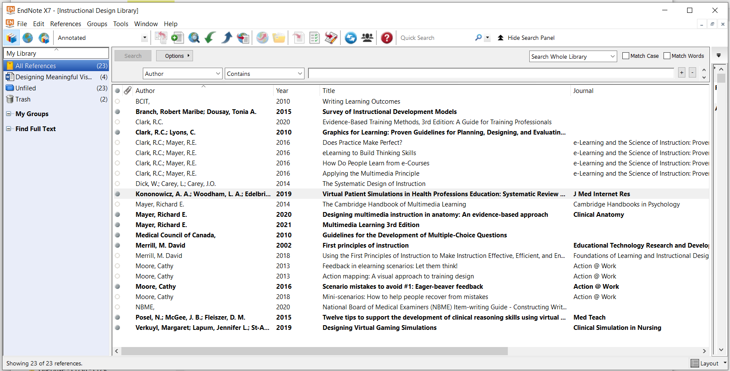
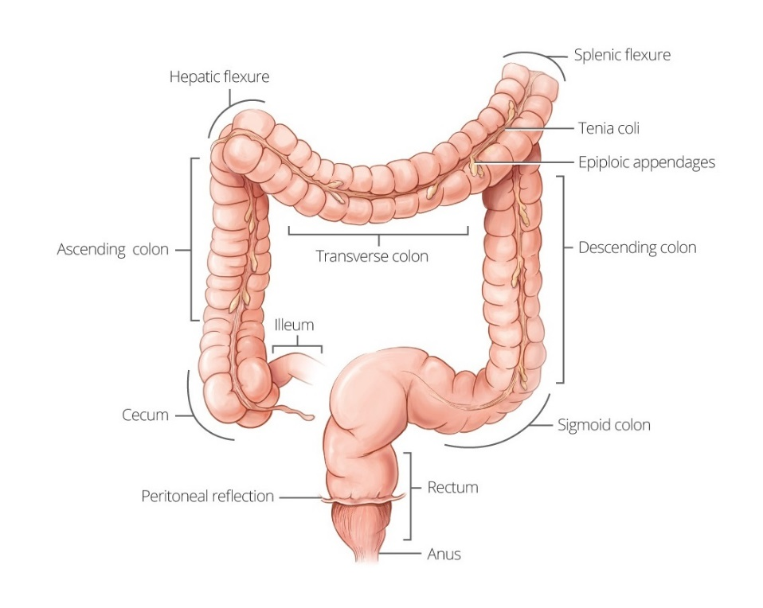
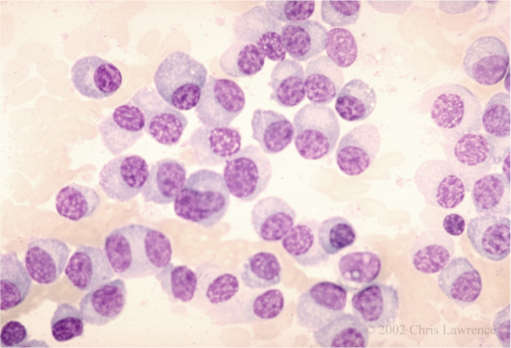
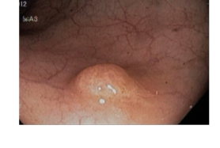
Representational Graphics
Teach the Appearance of Something Tangible
Clinical Photos
© Sharma & Baghmar (2013)
Used under CC BY-NC-SA 3.0
Screen Capture
Medical Imaging
© Charles F. Gould, via MedPix® (medpix.nlm.nih.gov)
Used with Permission.
Endoscopy
Simplified Illustrations of Tangible Objects
Histology Slides
© Shussman & Wexner (2014).
Used under CC BY 3.0 / cropped
© Christine Lawrence, MD, FACP, Health Education Assets Library (HEAL)
Used under CC BY-NC-ND 3.0
© de Souza Institute
Notes:
Definition: Shows the appearance of object e.g., photo, screen shot, simplified diagram of real object.
A Representational Visual can present information in a more concise way than can text.
Think about how much text was needed to describe the structure of the antibody earlier
Representational images can show concrete examples of a concept: e.g., clinical signs, patient case.
Examples:
Medical Imaging: MM lesions
Histology slide: MM cells.
Clinical Photo: hand-foot syndrome (Sharma & Baghmar, 2013).
Endoscopy image: Colonoscopy with polyp (Shussman & Wexner, 2014)
Screen capture of software or equipment
Simplified Diagram: Colon
Is your learning objective describing a tangible fact or concept? It could benefit from a representational graph

Slide 11
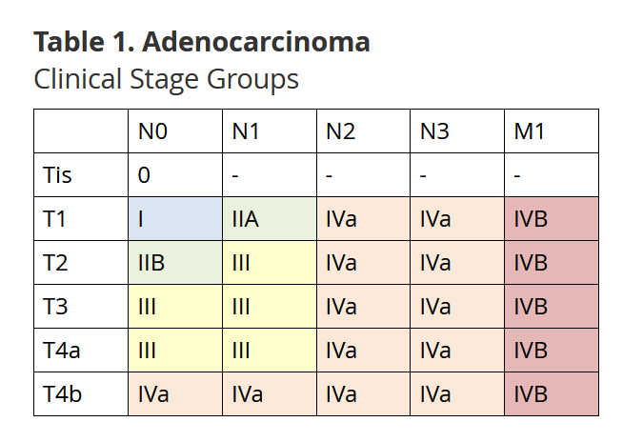
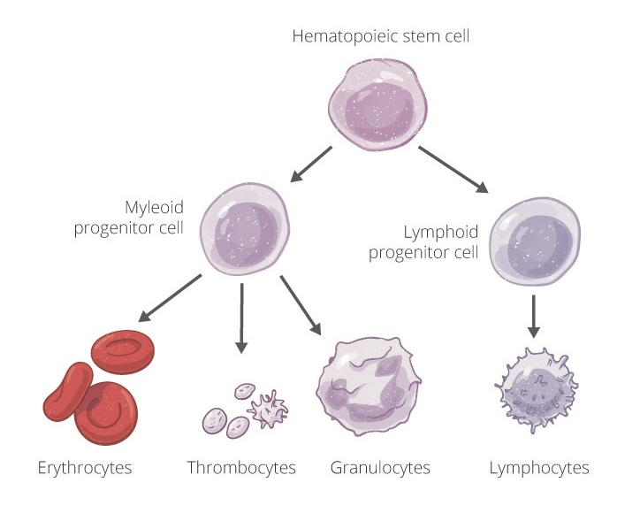
Organizational Graphics
Teach qualitative relationships: e.g., comparisons, hierarchy, lesson map
Matrix Table: Comparisons
Topic Map
Tree Diagram: Hierarchy
© de Souza Institute
(Clark, 2020; Clark & Lyons, 2010)
Notes:
Organizational Images can help learners build mental models of the relationships among facts and concepts, e.g., comparisons, hierarchy, topics
visuals that depict relationships between facts and concepts can support deeper learning and improve learner’s recall of the relationships
Novices esp. cannot make their own “mental images” when learning new info. Experts benefit less because they have their experience to draw from to organize the content in “mental images”
Examples:
Blood development tree chart
Staging colour coded table
Topic organization of lesson
Is your learning objective asking students to describe the relationship between multiple related facts and concepts? It could benefit from an organizational graphic.

Slide 12
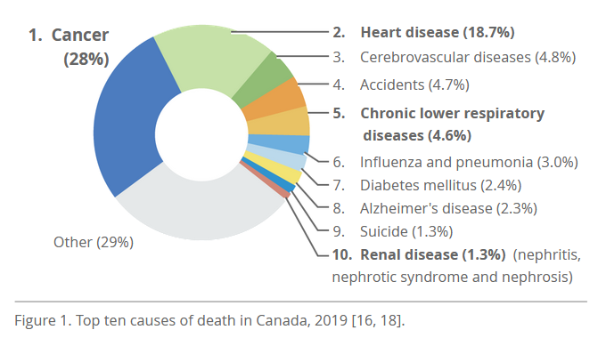
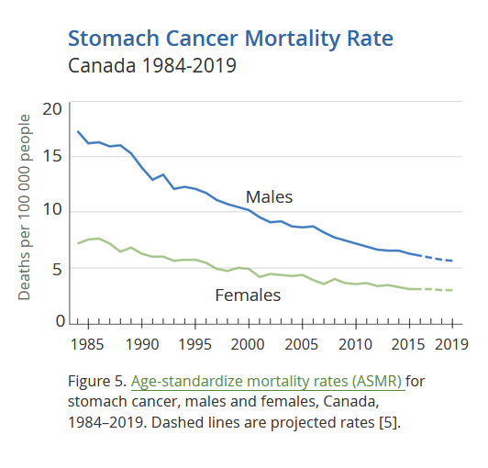
Relational Graphics
Teach quantitative relationships
Pie Chart
Line Graph
Infographic
Notes:
Relational Graphics show quantitative relationships between facts. Quantitative relationships are much easier and more efficient for learners to understand through visuals.
Examples:
Bar chart, pie chart
Line graph
Infographic – communicating risk
Is your learning objective asking students to describe quantitative relationships? It could benefit from a relational graphic.

Slide 13
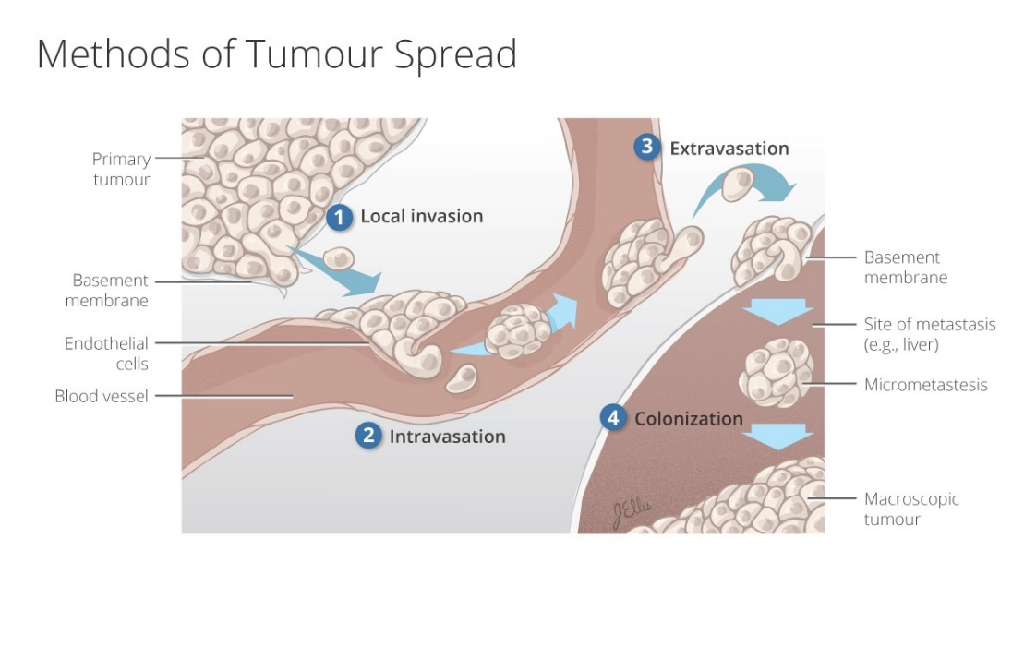
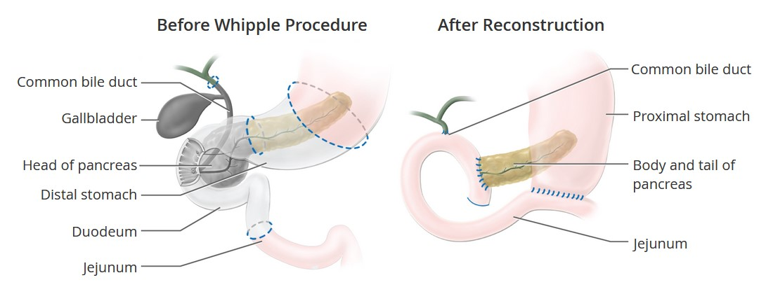
Transformational Graphics
Teach changes over time or space, e.g., “How it works” , “How to do it”
Clinical Process
Pathological Process
© de Souza Institute
Surgical Process
© de Souza Institute
Notes:
Use transformational visuals that illustrate change over time or space and help students to build cause and effect mental models. “How it works” mental models. “How to do it” mental models
Examples:
Safe Removal of gloves
Surgical Process
Pathological Process
Is your learning objective asking student to describe “how something works ” or ‘How to do something”? It could benefit from a transformational graphic.

Slide 14
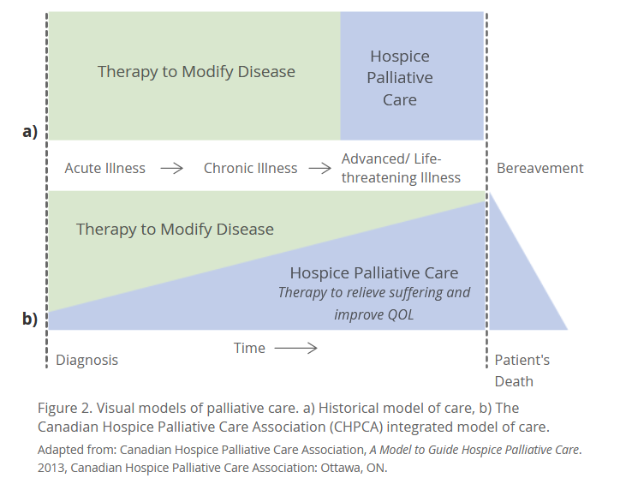
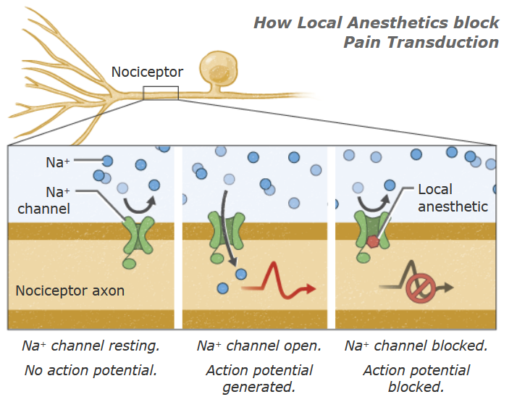
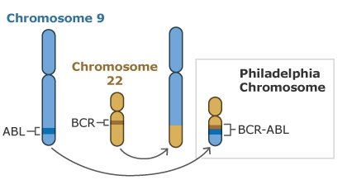
Interpretive Graphics
Visualize concepts or intangible phenomena: e.g., schematic diagrams
Schematic Diagram: Transformation
Schematic Diagram: Cause and Effect
© de Souza Institute
Conceptual Chart
© de Souza Institute
Notes:
Interpretive graphics help learners build understanding of events or processes that are invisible, abstract, or both (Clark & Lyons, 2010).
Interpretive graphics often depict abstract concepts, principles, or laws involving interactions among phenomena that are invisible such as molecular motion or genetic inheritance.
Interpretive visuals can help earners build “Cause and effect” mental models for more abstract processes.
Use interpretive visuals to illustrate laws and principles.
Conceptual graph (e.g., not quantitative facts)
Schematic diagrams (e.g., molecular process, genetics, circuit diagram etc.)
Is your learning objective asking students to understand an abstract concept or invisible phenomena? It could benefit from an interpretive graphic (schematic diagram)?

Slide 15
ONLINE QUIZ (4 min):
The Function of Graphics in Teaching
https://links.desouzainstitute.com/convergence2022

Slide 16
Is your learning objective describing….
What is your learning objective?
…a tangible fact or concept that could benefit from a representational graphic?
Are there existing visuals that will distract from the learning objective?
….multiple related facts and concepts that could benefit from an organizational graphic?
….quantitative relationships that could benefit from a relational graphic?
Yes
No
…a process or procedure that could benefit from a transformational graphic?
Delete!
…an abstract concept or invisible phenomena that could benefit from a interpretive graphic?
Notes:
Here’s a simplified process to plan instructional graphics, you’ll practice this in the break out groups.
Consider the following questions as you review your lesson content:
What is your learning objective? MOST IMPORTANT…if you don’t know what your learning objective is you cannot proceed to designing graphics.
Are there existing visuals that will distract from the learning objective?
Is your learning objective describing a tangible fact or concept that could benefit from a representational graphic?
Representational graphics can depict a specific example of a generalized fact/concept:
Visual Signs and Symptoms (Gross Anatomy, Tissue, Cells)
Clinical Environment or equipment, tools, software screen capture
Concepts can be shown visually with specific examples and non-examples (e.g., symptoms or safe use of equipment).
Representational graphics can depict a simplified or generalized appearance of something:
Gross Anatomy, Tissue, Cells
Clinical Environment or equipment, tools
Is your learning objective describing multiple related facts and concepts that could benefit from an organizational graphic?
What relationships between the facts/concepts are important in the lesson?
Hierarchy: Tree diagram
Time: Flow chart
Comparisons: Table (matrix)
Can lesson topics be shown graphically?
Is your learning objective describing quantitative relationships/data that could benefit from a relational graphic? line graph, bar graph, pie chart, infographic etc.
Is your learning objective describing a process (“how it works”) or procedure (‘How to do it”) that could benefit from a transformational graphic?
Photo/ illustration sequence of a clinical procedure.
Illustration sequence of physiological or pathological process?
Would the procedure benefit from an organizational or interpretive graphic (flow chart or decision tree)?
Am I trying to illustrate an abstract concept or invisible phenomena that could benefit from an interpretive graphic?
Are there abstract relationships that could be shown graphically? (e.g., models of care? Decision trees?)
Are you teaching an invisible cause and effect phenomena that could be shown as a schematic diagram? (e.g., molecular processes, electrical processes, mechanical processes? Patient pathway through the healthcare system?)
Adapted from (Clark, 2020; Clark & Lyons, 2010)

Slide 17
BREAKOUT ROOMS (15 min):
1. Open your group’s activity pdf: A, B, or C
What is the function of the current image on the slide?
Does the image support the learning objective? Does it distract from the learning objective?
Do you have any suggestions of instructional graphics that would better support the learning objective?
What is the function of your suggested visual? (e.g., representational, organizational, etc.)
2. Pick one person from your group to briefly present your group’s ideas (1 min)
We will paste a link to the activity pdfs into your breakout room’s chat.
Notes:
During the breakout room activity, we’ll give your group a slide from one of our courses that contains an image.
Demo Group A pdf:
On the first page is an actual slide form one of our courses along with a learning objective.
The second page contains four discussion questions.
Page 3 is just a summary of the previous flow chart – its just there for your reference.
Once you accept the invitation for a breakout room, Jiahui and I will go to each room and give you a link to your group’s activity pdf, if you’re waiting a minute for us you can introduce yourselves to your group.
Pick one person from your group to briefly present your group’s ideas to everyone (1 min or so)
We’ll meet back in 15min? e.g., 2:35pm?
Shortlinks:
Download exercise pdf for Group A: https://links.desouzainstitute.com/groupa
Download exercise pdf for Group B: https://links.desouzainstitute.com/groupb
Download exercise pdf for Group C: https://links.desouzainstitute.com/groupc

Slide 18
Group A
Learning Objective: Compare the incidence and mortality rates for males and females diagnosed with pancreatic cancer.
Notes:
Download exercise pdf for Group A: https://links.desouzainstitute.com/groupa

Slide 19
Group B
Learning Objective: Explain the role of the blood-brain and blood-nerve barriers in protecting the nervous system from chemotherapy agents.
Notes:
Download exercise pdf for Group B: https://links.desouzainstitute.com/groupb

Slide 20
Group C
Learning Objective: Locate common assessment scales for older persons with cancer including comorbidity scales, cognitive impairment scales, and polypharmacy scales.
Notes:
Download exercise pdf for Group C: https://links.desouzainstitute.com/groupc

Slide 21
Public Domain Images
The image creator has given up their copyright. Images licensed as Public Domain may be distributed, remixed, adapted, and built upon in any medium or format, with no conditions.
Creative Commons Images
The image creator has retained their copyright, but allows others to use their image under 1-4 conditions:
BY - Credit must be given to the creator
NC - Only noncommercial uses of the work are permitted
ND - No derivatives or adaptations of the work are permitted
SA - Adaptations must be shared under the same terms
Notes:
Often, after you figure out what type of image would support your learning objective, you may not have resources to create a custom image (esp. representational/interpretive images), so Public Domain and Creative Commons licensed images can be a great alternative.
Public Domain Images
The image creator has given up their copyright. Images licensed as Public Domain may be distributed, remixed, adapted, and built upon in any medium or format, with no conditions.
Creative Commons Images – are more complicated, the original creator still retains copyright but allows others to use their image under 1-4 conditions.
BY - Credit must be given to the creator
NC - Only noncommercial uses of the work are permitted (e.g., cannot use it in a social media advertisement, but can use it on a course slide)
ND - No derivatives or adaptations of the work are permitted (e.g., cannot crop or modify colours etc.)
SA - Adaptations must be shared under the same terms (e.g., if you make modifications to the illustration or photo, your modifications are also license as creative commons)

Slide 22
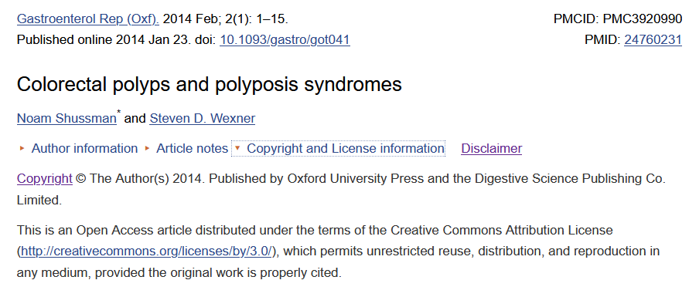
Sourcing Creative Commons and Public Domain Images
Open-Access Journals (e.g., https://openi.nlm.nih.gov/)
US National Institutes of Health Media Libraries, e.g.,
www.niddk.nih.gov/news/media-library
https://visualsonline.cancer.gov/
Wikimedia Commons Libraries (commons.wikimedia.org)
Open Licensed Textbooks (e.g., https://openstax.org/subjects/sciopenence)
Google Image Search and Flickr can filter for Creative Commons images
Always double check the specific CC license
for each image that you’d like to use.
Notes:
Some general strategies I use for sourcing quality Creative Commons images (i.e., source from a reputable image library, such as government or published journals)
Open-Access Journals (e.g., https://openi.nlm.nih.gov/) DEMO – OPEN TAB
Always double check the license of the image you’d like to use, for example the image of the colon polyp used earlier in the presentation is license under CC-BY with meant hat the only condition of re-use is that I give proper attribution to the authors.
US National Institutes of Health Media Libraries, e.g.,
www.niddk.nih.gov/news/media-library DEMO – OPEN TAB
https://visualsonline.cancer.gov/
Wikimedia Commons Libraries (commons.wikimedia.org)
Open Licensed Textbooks (e.g., https://openstax.org/subjects/sciopenence)
Google Image Search and Flickr can filter for Creative Commons images
If you find a copyrighted image that you would like to use, ask permission from the author.

Slide 23
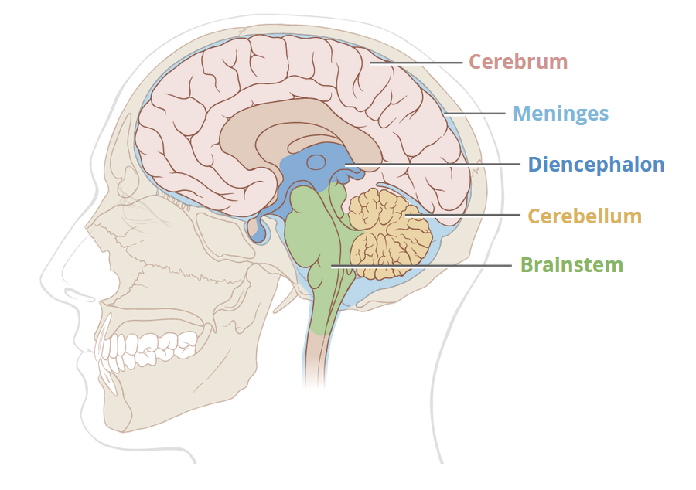
Attribution for Creative Commons Images
Image is a derivative of “Skull and brain sagittal section” by Patrick J. Lynch, medical illustrator; C. Carl Jaffe, MD, cardiologist. Used under CC BY 2.5
Title & Source– link to original source
Author/Creator
License – link to license
Any modification – if allowed under license
Image is a derivative of “Skull and brain sagittal section” by Patrick J. Lynch, medical illustrator; C. Carl Jaffe, MD, cardiologist. Used under CC BY 2.5
Image is a derivative of “Skull and brain sagittal section” by Patrick J. Lynch, medical illustrator; C. Carl Jaffe, MD, cardiologist. Used under CC BY 2.5
https://wiki.creativecommons.org/wiki/Best_practices_for_attribution
Notes:
Creative Commons images require that you give attribution to the original creator when re-publishing them. Your attribution should contain:
Title & Source– link to original source
Author/Creator
License – link to license
Any modification – if allowed under license (e.g., cropped, adding labels, altering colours)
Its good practice to cite all of your images – even ones that are Public Domain.
The link on the slide goes into depth on how to properly cite creative commons images: https://wiki.creativecommons.org/wiki/Best_practices_for_attribution

Slide 24
Design Guide & Resource List
We’ve written a design guide to help you apply what we’ve covered in the workshop, which includes:
A general process for planning graphics that support your objectives.
A list of Creative Commons and Public Domain image libraries that are relevant to health professions education.
Available here: https://www.desouzainstitute.com/convergence-2022/
Notes:
We’ve written a design guide to help you apply what we’ve covered in the workshop, which includes.
A general process for planning graphics that support your objectives.
A list of Creative Commons and Public Domain image libraries that are relevant to health professions education to help you get started sourcing quality images for your eLearning modules and presentation

Slide 25
Q & A
What challenges have you faced when planning or sourcing images for use in your teaching?
Do you have any image libraries/resources you’d like to share?
Thank You!
Jerusha Ellis, Jerusha.Ellis@desouzainstitute.com
Jiahui Wong, Jiahui.Wong@desouzainstitute.com

Slide 26
References
Clark, R. C. (2020). Evidence-Based Training Methods, 3rd Edition: A Guide for Training Professionals: American Society for Training & Development.
Clark, R. C., & Lyons, C. (2010). Graphics for Learning: Proven Guidelines for Planning, Designing, and Evaluating Visuals in Training Materials: Wiley.
Clark, R. C., & Mayer, R. E. (2016). Applying the Multimedia Principle in e-Learning and the Science of Instruction: Proven Guidelines for Consumers and Designers of Multimedia Learning (4 ed., pp. 67-87): Wiley.
Mayer, R. E. (2021). Multimedia Learning 3rd Edition: Cambridge University Press.
Image References
Sharma, A., & Baghmar, S. (2013). Hand foot syndrome associated with standard dose cytarabine. Indian journal of medical and paediatric oncology : official journal of Indian Society of Medical & Paediatric Oncology, 34(4), 333-333. doi:10.4103/0971-5851.125263
Shussman, N., & Wexner, S. D. (2014). Colorectal polyps and polyposis syndromes. Gastroenterol Rep (Oxf), 2(1), 1-15. doi:10.1093/gastro/got041

